Slide 1
Model checking of multicore software using CBMC
Ashok Kelur

Slide 2
Outlines
Thesis goals
Ericsson’s multicore platform
Model checking and CBMC
DSP-C
Ericsson code
Contract verification
Verification on Ericsson code
Verification of multicore software
Future work
Conclusion

Slide 3
Thesis
Propose and implement verification techniques for Ericsson’s multicore software
  Study Ericsson’s platform
  Add support in CBMC
    DSP-C
    Ericsson’s multicore platform libraries
  Verification runs on the code
    Contract verification
  Unprotected access to shared resources

Slide 4
Ericsson’s multicore platform
Multiple Digital Signal Processing (DSP) cores
Uses DSP-C language
Non-Uniform Memory Access
Large code base for one product
  LTE base station
  Interdependent modules
  Concurrent
  Lots of inter-process communication
More to come in next slides

Slide 5
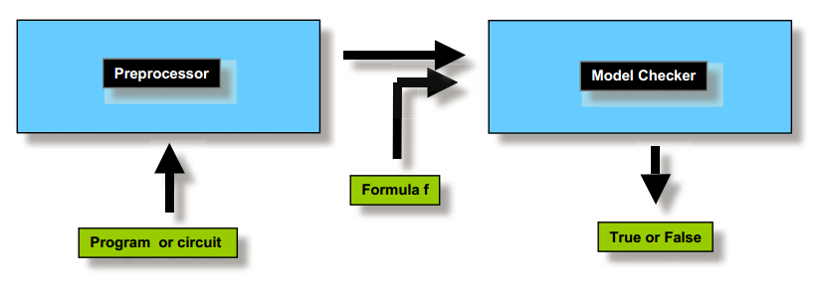
What is model checking?
Image from: E M. Clarke, The Birth of Model Checking, Springer, 2008.

Slide 6
Example: What else can it do?
S1
Initialize
S2
N operations
Sn
Z = 200
Z = 200;
if(0 < x && x< 100)
{
if(x > 2)
{
ans = z / (x-2);
}
else
{
assert(0);
}
}
!(0 < x < 100)
0 < x < 100
Sn+2
Sn+1
X <= 2
X > 2
Sn+4
Sn+3
ans=z/(x-2)
M operations
Sn+m

Slide 7
CBMC
Bounded model checker for ANSI-C and C++
Front-end converts programs into Control Flow Graph (CFG)
Use CFG for Bounded Program Analysis
CBMC Tool
Frontend
C/C++
Source
Parse
Tree
CFG
Bounded Program
Analyses

Slide 8
Example
CFG
Z = 200;
if(0 < x && x<100)
{
if(x > 2)
{
z = z / (x-2);
}
else
{
assert(0);
}
}
Z = 200
if
0 < x < 100
if
x<=2
x>2
assert(0)
z=z/(x-2)

Slide 9
Bounded Program Analyses
Z = 200
if
0 < x < 100
z = 200
^ 0<x<100
^ x <= 2
if
x<=2
x>2
z = 200
^ 0<x<100
^ x > 2
^ z = z / (x-2)
z=z/(x-2)
assert(0)

Slide 10
Bounded Program Analyses
Z = 200
Provides values on any path
if
0 < x < 100
^ z = 200
^ 0<x<100
^ x <= 2
if
x<=2
x>2
z = 200
^ 0<x<100
^ x > 2
^ z = z / (x-2)
z=z/(x-2)
assert(0)

Slide 11
How do we solve decision problem?
How do we analyse if it is possible to reach there?
SAT - Satisfiability

Slide 12
Example: Is it possible to reach red state?
Automatically check if this can be true?
z = 200
^ 0<x<100
^ x <= 2
S1
Initialize
S2
N operations
Sn
Z = 200
Z = 200;
if(0 < x && x< 100)
{
if(x > 2)
{
ans = z / (x-2);
}
else
{
assert(0);
}
}
!(0 < x < 100)
0 < x < 100
Sn+2
Sn+1
X <= 2
X > 2
Sn+4
Sn+3
ans=z/(x-2)
M operations
Sn+m

Slide 13
How do we solve decision problem?
How do we analyse if it is possible to reach there?
For bit-vector arithmetic, the standard way of deciding satisfiability of the formula is flattening followed by a call to a propositional SAT solver.
SAT - Satisfiability

Slide 14
Steps of CBMC
Parse and create CFG
Frame formulas for paths in question
Flatten the formulas
Use SAT solvers to check satisfiability
        Decision procedure, Daniel Kroening and Ofer Strichman
CFG – Control flow Graph
CNF – Canonical Normal Form
SAT – Satisfiability

Slide 15
CBMC
Verifies
  Array bounds
  Pointer safety
  User specified assertions
  And more...

Slide 16
DSP-C
An extension to ISO/IEC IS 9899:1900 (ISO C) standard to support the hardware features of DSPs
The new features
  Fixed point data types - Added support in CBMC
  Divided Memory Spaces - Added support in CBMC
  Dedicated register sets - Added support in CBMC
  Circular buffers

Slide 17
Ericsson code
Porting platform
Assembly code
Large code base and complex build system
Complex Inter-process/inter-thread communication

Slide 18
Ericsson code
handleSignal
(int sigNum, dataType *ptr, …)
{
…
packetId = ptr[idIndex];
packetData = &ptr[dataIndex];
packetLen = getPacketLen(ptr);
…
for(i=0; i<packetLen; i++)
{
…
}
}

Slide 19
Ericsson code
handleSignal
(int sigNum, dataType *ptr, …)
{
…
packetId = ptr[idIndex];
packetData = &ptr[dataIndex];
packetLen = getPacketLen(ptr);
…
for(i=0; i<packetLen; i++)
{
…
}
}
No way to statically identify content of data buffer

Slide 20
Ericsson code
handleSignal
(int sigNum, dataType *ptr, …)
{
…
packetId = ptr[idIndex];
packetData = &ptr[dataIndex];
packetLen = getPacketLen(ptr);
…
for(i=0; i<packetLen; i++)
{
…
}
}
No way to statically identify content of data buffer
Large code with unbounded loops and recursion
False positives

Slide 21
Contract Programming
Each module/function defines
  Preconditions
  Postconditions
  Invariants
Advantages
  Teams working on different modules of same product can avoid integration errors
  Each developer defines constraints to keep his module safe

Slide 22
Contract Programming
handleSignal
(int sigNum, packetType *packet, …)
{
precondition(condition)
…
packetId = packet[idIndex];
packetData = &packet[dataIndex];
…
postcondition(condition)
}

Slide 23
Example: Contracts
fun_A: x, y, z: int,
returns k
preconditions(0<x<100)
x = x % 10;
z = fun_B(x, y)
postcondition(0<x<10)
invariants(y)
fun_B: x, y: int,
returns z
preconditions(0<x<10)
return x + y;
postcondition(...)
invariants(...)

Slide 24
Verification using contracts
fun_A: x, y, z: int,
returns k
preconditions(0<x<100)
x = x % 10;
z = fun_B(x, y)
postcondition(0<x<10)
invariants(y)
fun_B: x, y: int,
returns z
preconditions(0<x<10)
return x + y;
postcondition(...)
invariants(...)

Slide 25
Verification using contracts
Verify functionality of a function by assuming
preconditions and asserting on postcondition
fun_A: x, y, z: int,
returns k
precondition(0<x<100)
x = x % 10;
z = fun_B(x, y)
postcondition(0<x<10)
invariants(y)
fun_B: x, y: int,
returns z
preconditions(0<x<10)
return x + y;
postcondition(...)
invariants(...)

Slide 26
Verification using contracts
Verify functionality of a function by assuming
preconditions and asserting on postcondition
fun_A: x, y, z: int,
returns k
assume(0<x<100)
x = x % 10;
z = fun_B(x, y)
assert(0<x<10)
invariants(y)
fun_B: x, y: int,
returns z
assume(0<x<10)
return x + y;
assert(...)
invariants(...)

Slide 27
Verification using contracts
Verifying contracts between functions:
1. Assume precondition of caller
2. Asserting precondition of callee
3. Assume postcondition of callee
4. Assert on postcondition of caller
fun_A: x, y, z: int,
returns k
assume(0<x<100)
x = x % 10;
z = fun_B(x, y)
assert(0<x<10)
invariants(y)
fun_B: x, y: int,
returns z
assert(0<x<10)
return x + y;
assume(...)
invariants(...)

Slide 28
Verification on Ericsson code
Initialization process
Developers write the contracts
No way to get signal data during static analyses
False positives

Slide 29
Verification on Ericsson code
State space explosion due to recursion and loops
Limited by memory and computation
Decide on bounding parameters

Slide 30
Verification of multicore software
Concurrency is handled through scheduling
What can we do?
  Race conditions? – Ericsson handles through hardware support.
  Detecting access to shared data in unprotected block.
  Deadlock detection.

Slide 31
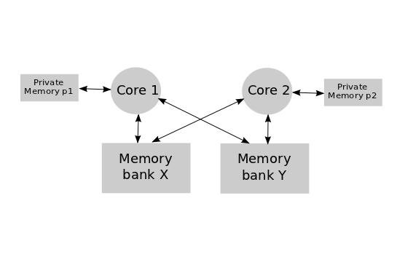
Detecting access to shared data in unprotect code block
Take advantage of divided memory spaces
  __X int a, __Y *ptr;
  __Y int b;
  Ptr = &b;

Slide 32
Future work
Techniques to detect the deadlock and unprotected shared resource access
  Earlier work done in Eraser (A Dynamic Data Race Detector for Multithreaded Programs).

Slide 33
Conclusion
The contracts used in actual code base were just dynamic value checks
Verifying code not written for static analyses can lead to flood of false positives
Verification still limited by computation speed and memory size
Developers need to learn about verification tools
Design top-down and define contracts on modules

Slide 34
Questions?

Slide 35


Thank you
Philipp Rümmer
Parosh Aziz Abdulla
Thomas Magnusson
Kenneth Andersson

Slide 36
Backup slides..

Slide 37
What about loops?
Unroll them..
While(cond)
body
if(cond)
body
While(cond)
body
if(cond)
body
if(cond)
body
While(cond)
body

Slide 38
What about loops?
Unroll them..
While(cond)
body
if(cond)
body
if(cond)
body
if(cond)
body
assume(!cond)
if(cond)
body
While(cond)
body

Slide 39
Flattening Bit-Vector Arithmetic
How to flatten x + y?

Slide 40
Flattening Bit-Vector Arithmetic
How to flatten x + y (one bit addition)?
Build circuit that adds them!
x
y
Cin
Full Adder
S=(x+y+i)mod 2=>x xor y xor i
O=(z+y+i)div 2=>x.y+x.i+y.i
FA
Cout
s
The full adder in CNF
(x or y or !o) . (x or !y or i or !o) . (a or !b or !i o)
. (!a or b or i !o) . (!a or b !i or o) . (!a or !b or o)

Slide 41
Flattening Bit-Vector Arithmetic
Multiple bits
Use Carry chain adder
x6
y6
x5
y5
x4
y4
x3
y3
x2
y2
x1
y1
x0
y0
Cin
FA
FA
FA
FA
FA
FA
FA
Cout
s6
s5
s4
s3
s2
s1
s0

Slide 42
Flattening Bit-Vector Arithmetic
Other operations like Multiplication, division or modulo
  Lead to very large formulas

Slide 43
Multicore data races
Case study: IBM Cell processors
Main Memory
BUS
controller
controller
controller
controller
Processor
core1
Processor
core2
Processor
core3
Processor
core4
Local memory
Local memory
Local memory
Local memory
Controller – Memory controller / Accelerator

Slide 44
Multicore data races
Case study: IBM Cell processors
Main Memory
BUS
controller
controller
controller
controller
Asynchonous
Data copy
Processor
core1
Processor
core2
Processor
core3
Processor
core4
Local memory
Local memory
Local memory
Local memory
Controller – Memory controller / Accelerator

Slide 45
Multicore data races
Case study: IBM Cell processors
Main Memory
BUS
Start DMA
Request
controller
controller
controller
controller
Asynchonous
Data copy
Processor
core1
Processor
core2
Processor
core3
Processor
core4
Local memory
Local memory
Local memory
Local memory
Controller – Memory controller / Accelerator

Slide 46
Multicore data races
Case study: IBM Cell processors
Main Memory
BUS
Start DMA
Request
controller
controller
controller
controller
Asynchonous
Data copy
DMA Request
Completed
asynchronously
Processor
core1
Processor
core2
Processor
core3
Processor
core4
Local memory
Local memory
Local memory
Local memory
Controller – Memory controller / Accelerator

Slide 47
Multicore data races
Case study: IBM Cell processors
Main Memory
BUS
Start DMA
Request
controller
controller
controller
controller
Asynchonous
Data copy
DMA Request
Completed
asynchronously
Processor
core1
Processor
core2
Processor
core3
Processor
core4
DMA Race
Local memory
Local memory
Local memory
Local memory
Controller – Memory controller / Accelerator

Slide 48
Multicore data races
After platform study we concluded that Ericsson avoids races through hardware support

Slide 49
DSP-C : Fixed point types
The new types added
  __fixed, short __fixed, long __fixed
    stores values between [-1, +1]
    For example: 0.125r
  __accum, short __accum, long __accum
    stores values between [-256, +256]
    For example: 8.25a

Slide 50
DSP-C : Memory regions
Language is extended to explicitly handle Non-Uniform Memory Access (NUMA) architecture using labels.
An example of NUMA Architecture
Porcessor
Core 1
Processor
Core 2
Memory bank X
Memory bank Y

Slide 51
DSP-C : Memory regions
Variable definition looks like,
  __X int a, __Y *ptr;
  __Y int b;
  Ptr = &b;
Variable definition looks like,
  __X int a, __Y *ptr;
  __Y int b;
  Ptr = &b;
An example of NUMA Architecture
An example of NUMA Architecture
Porcessor
Core 1
Porcessor
Core 1
Processor
Core 2
Processor
Core 2
Memory bank X
Memory bank X
Memory bank Y
Memory bank Y

Slide 52
Demo...

Slide 53
Questions?

